Slide 1
ONLINE DEMO WITH WEBSITE LINKS
WEBSITE-DEMO
websitelink
BackendDemo
AWSDEMOFORFRONTENDBACKENDANDBONUSPOINTS
Cloudfrontendpoint
Architecture-Discussion

Slide 2
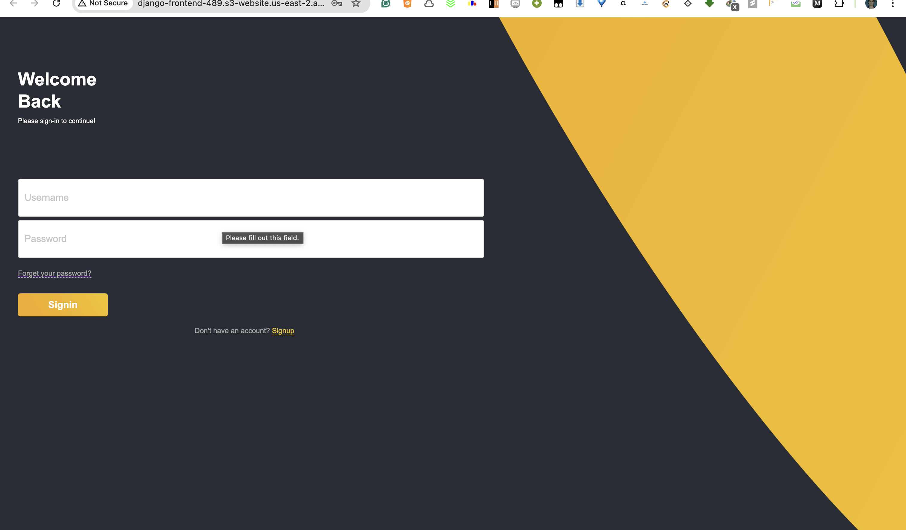

Slide 3
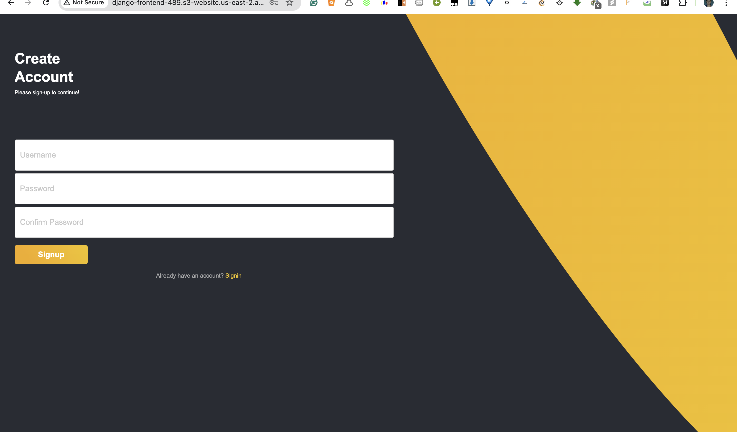

Slide 4
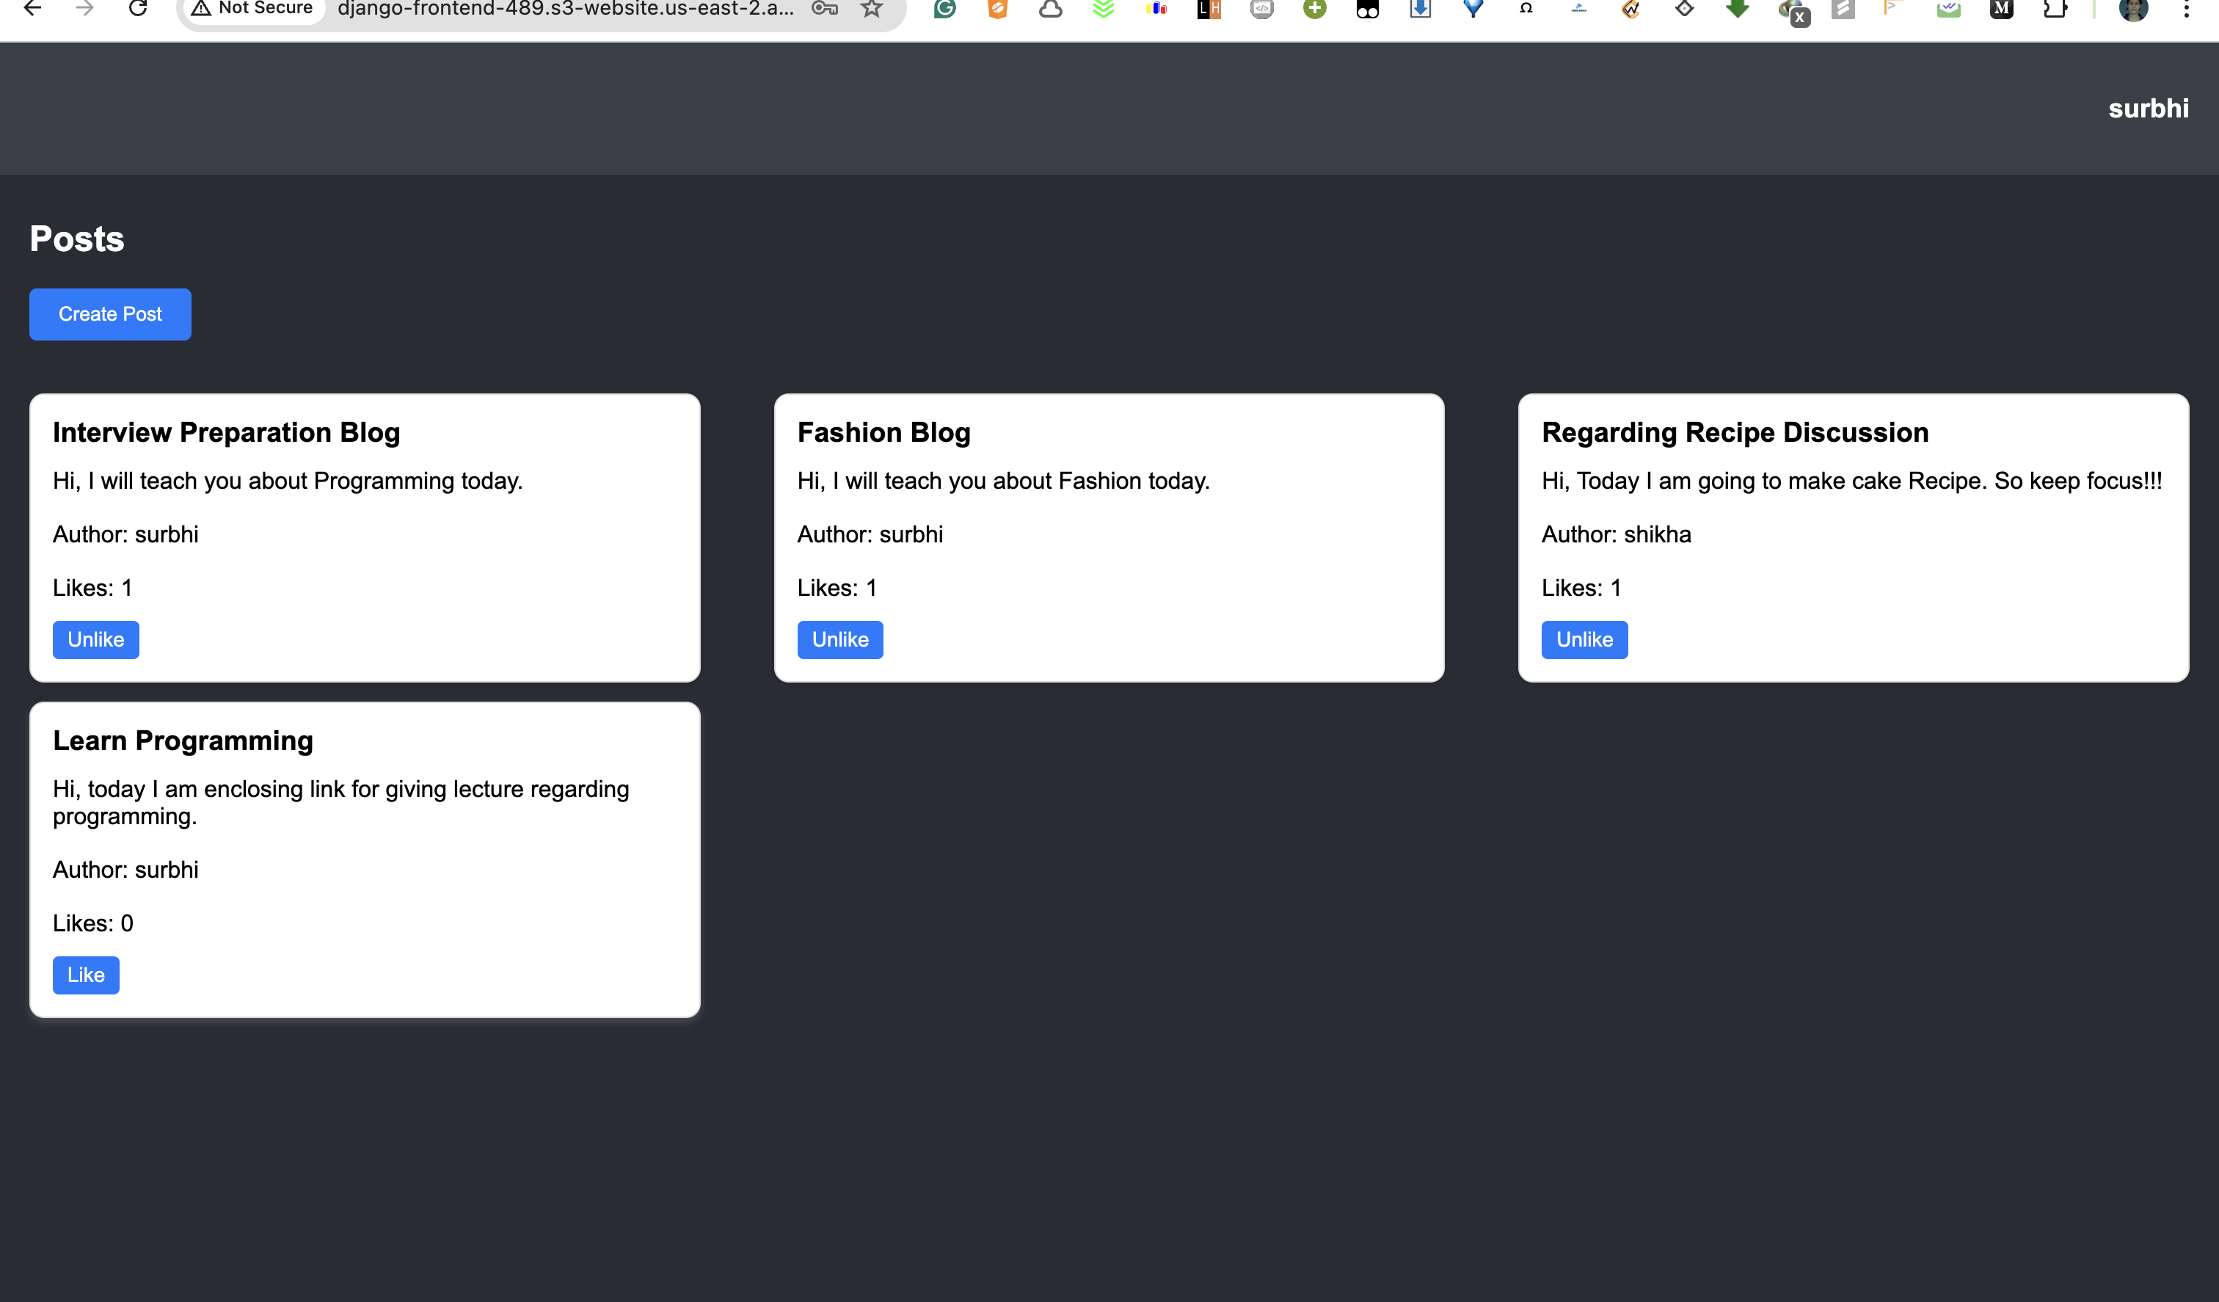

Slide 5
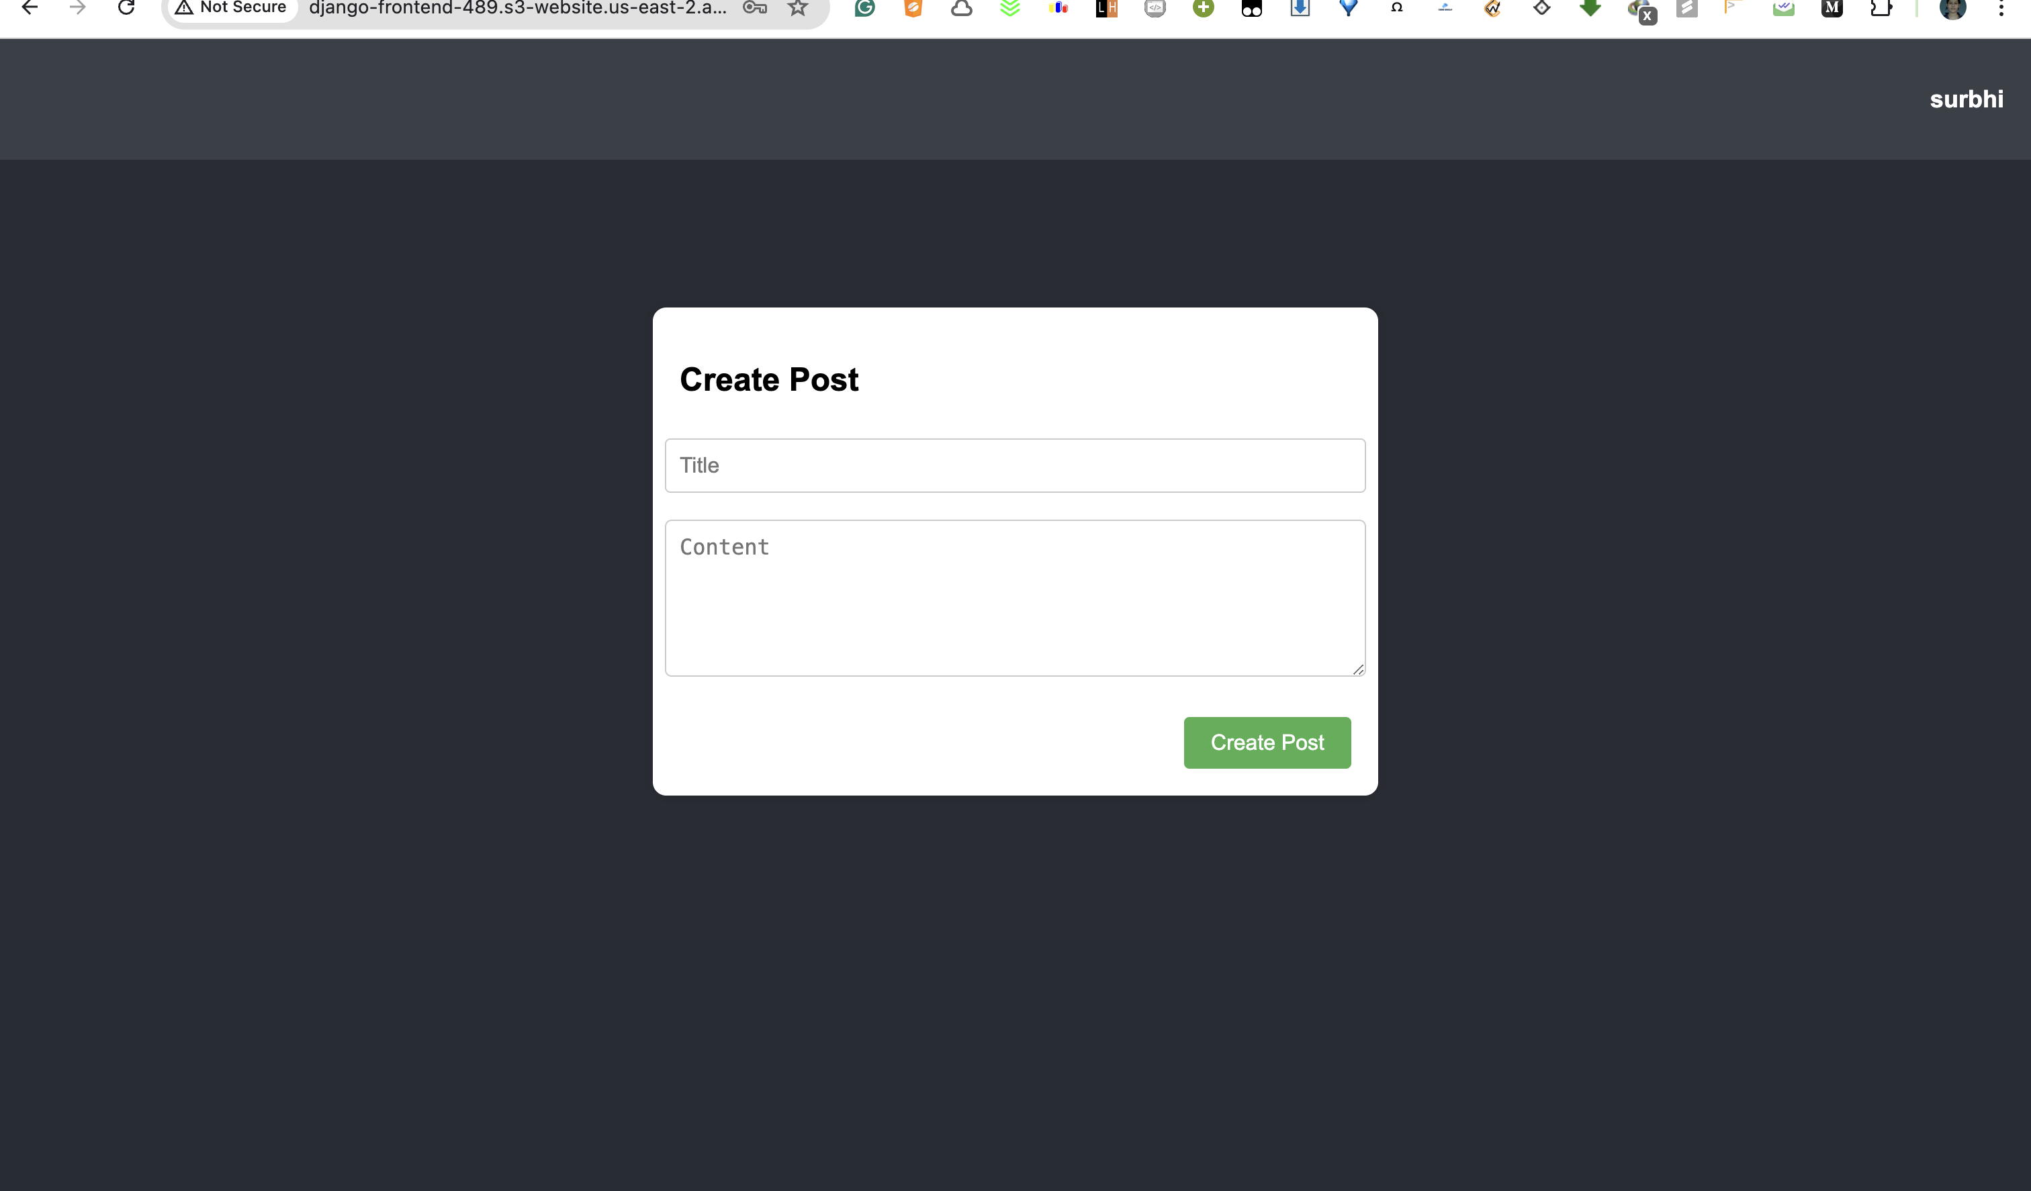

Slide 6
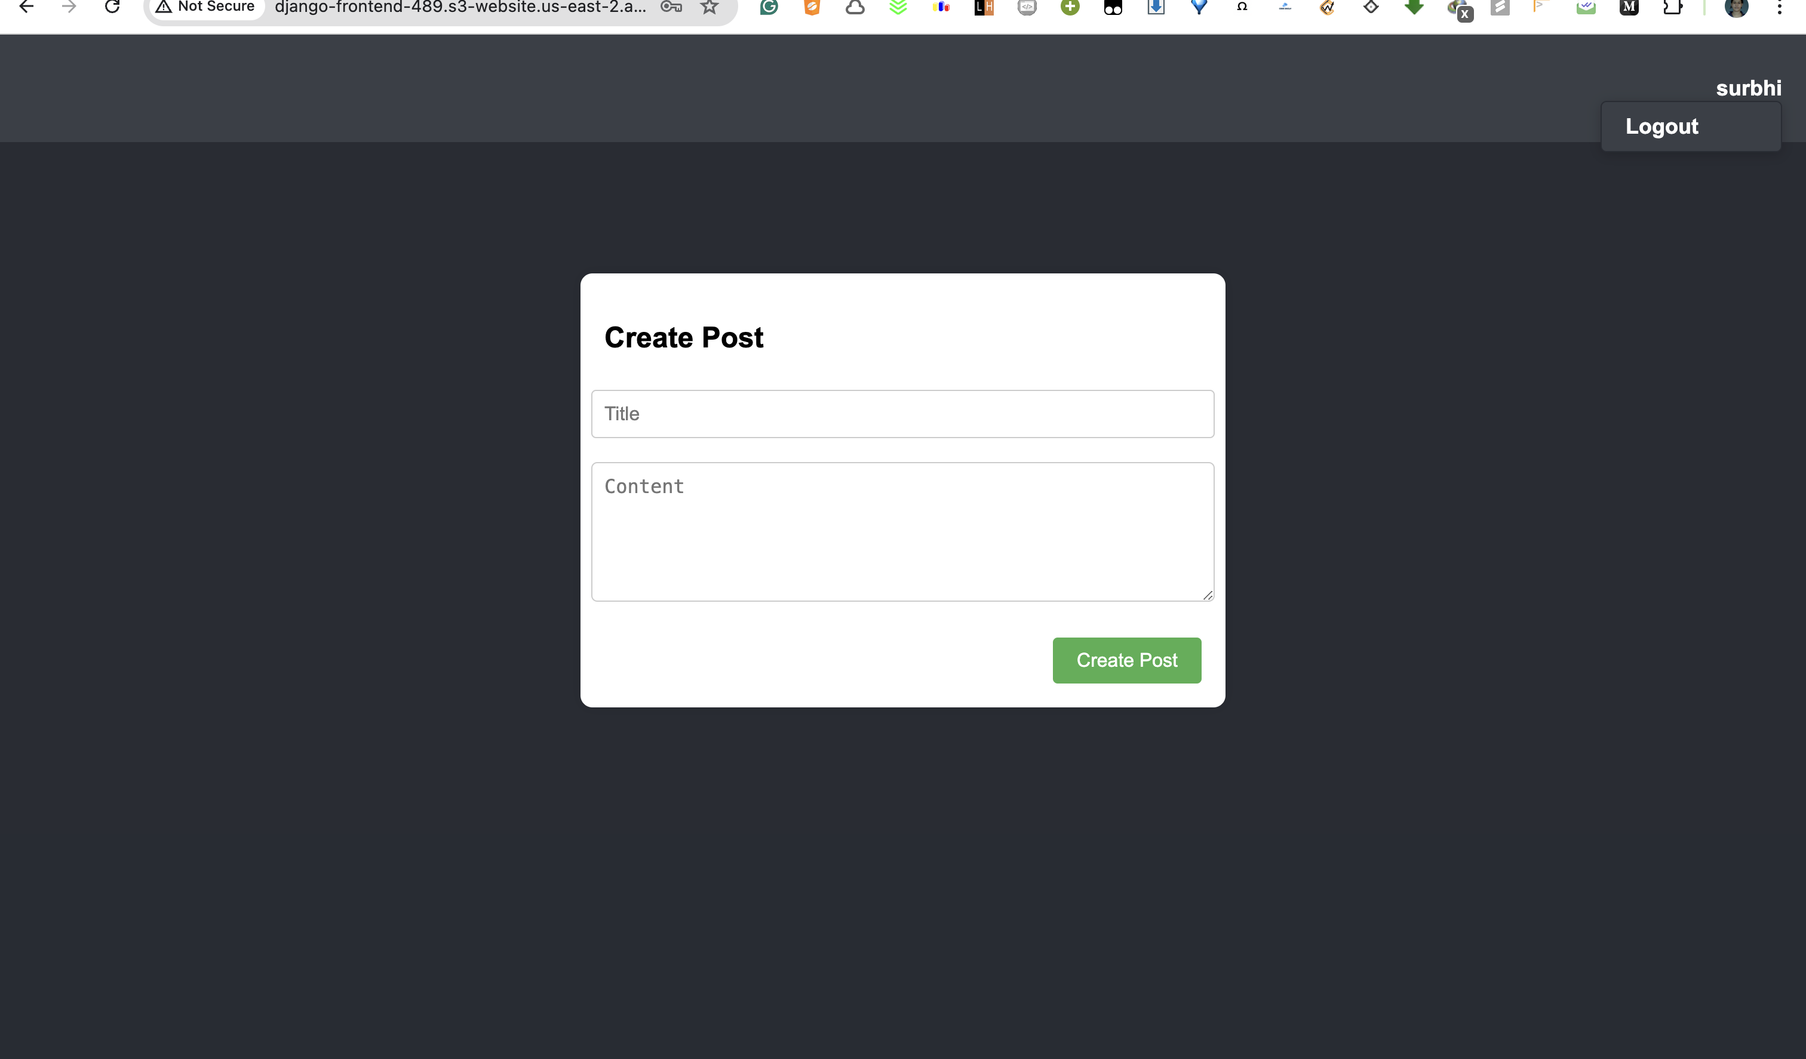

Slide 7
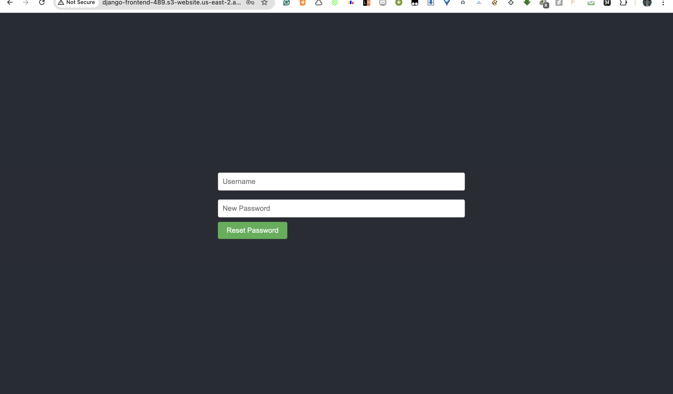

Slide 8
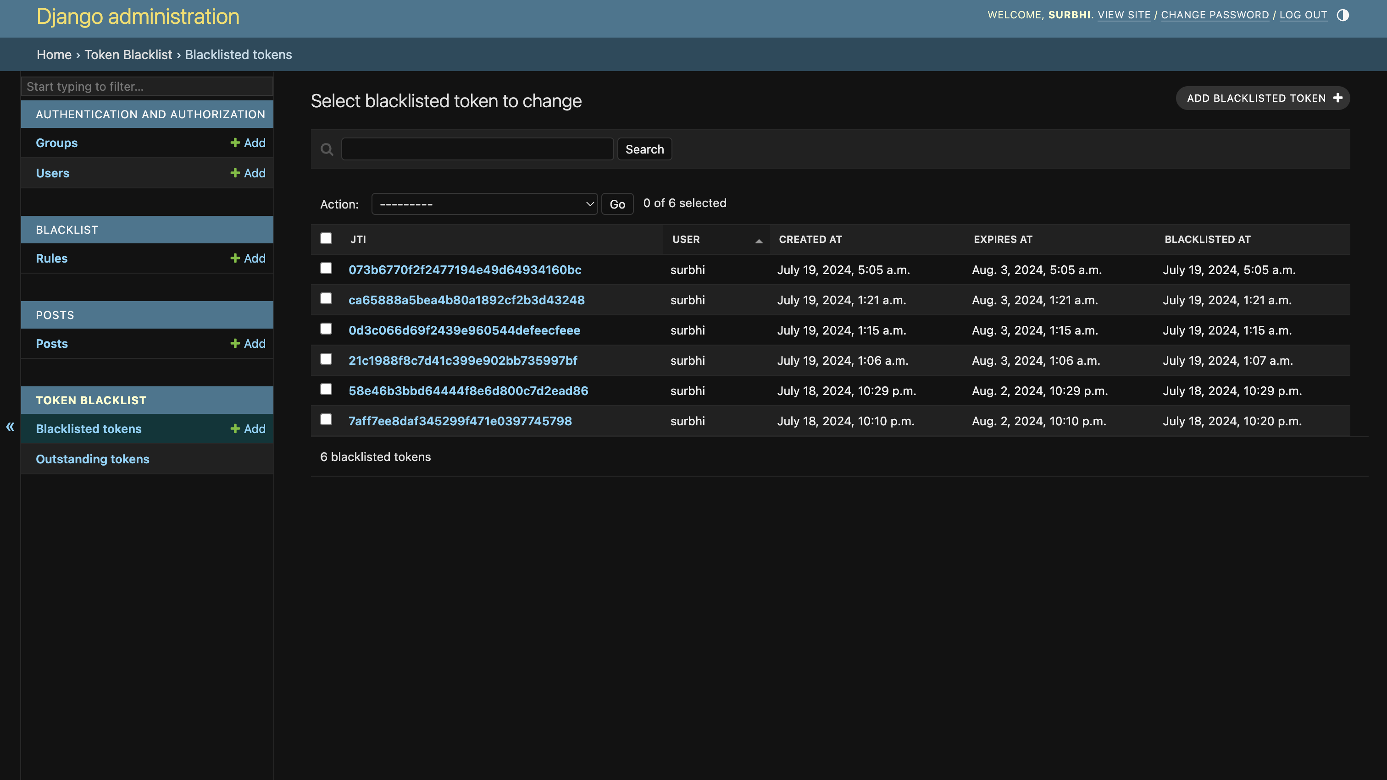

Slide 9
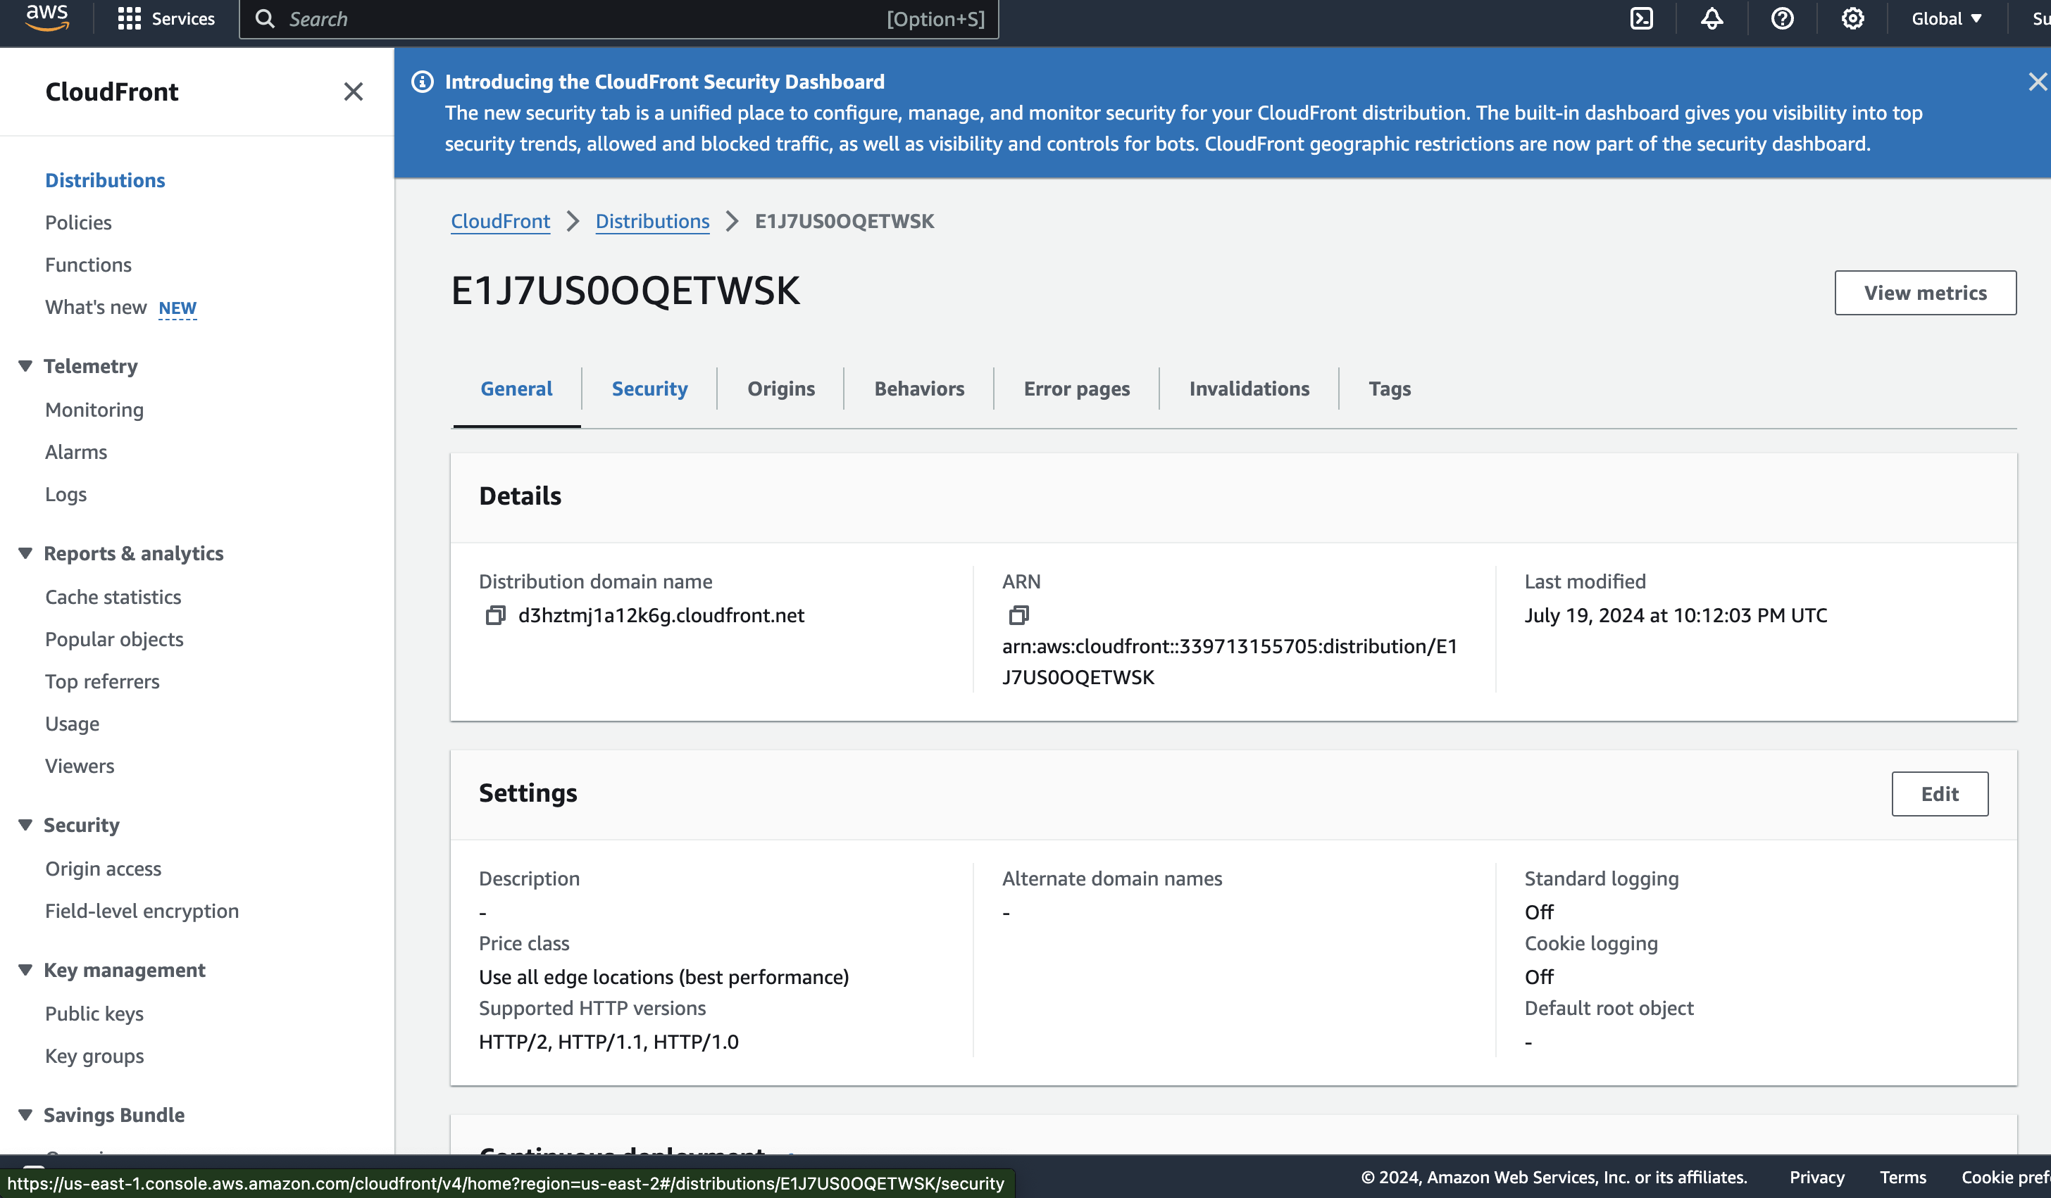
CLOUDFRONT

Slide 10
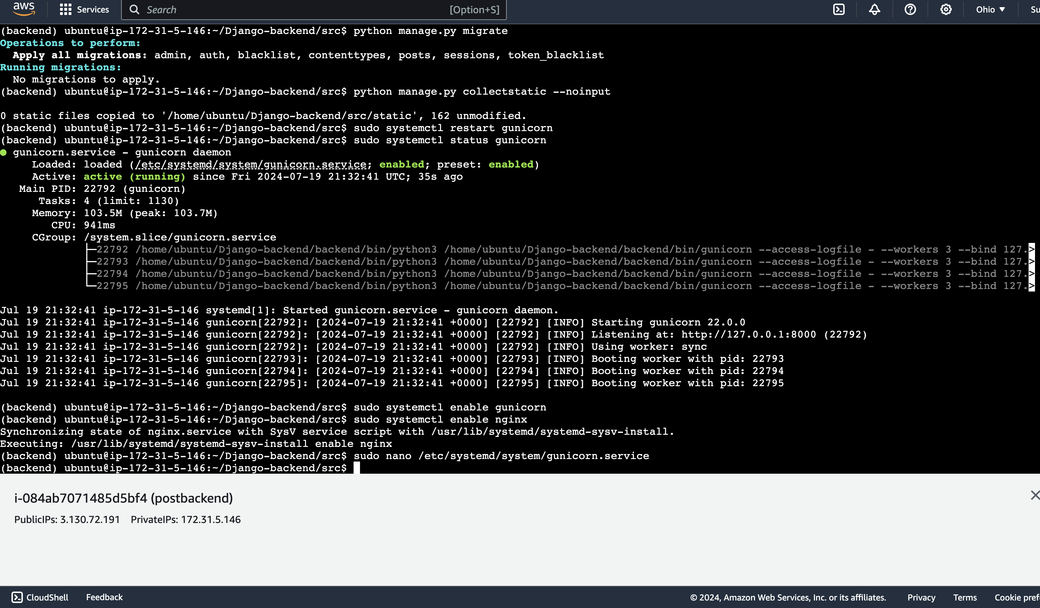

Slide 11
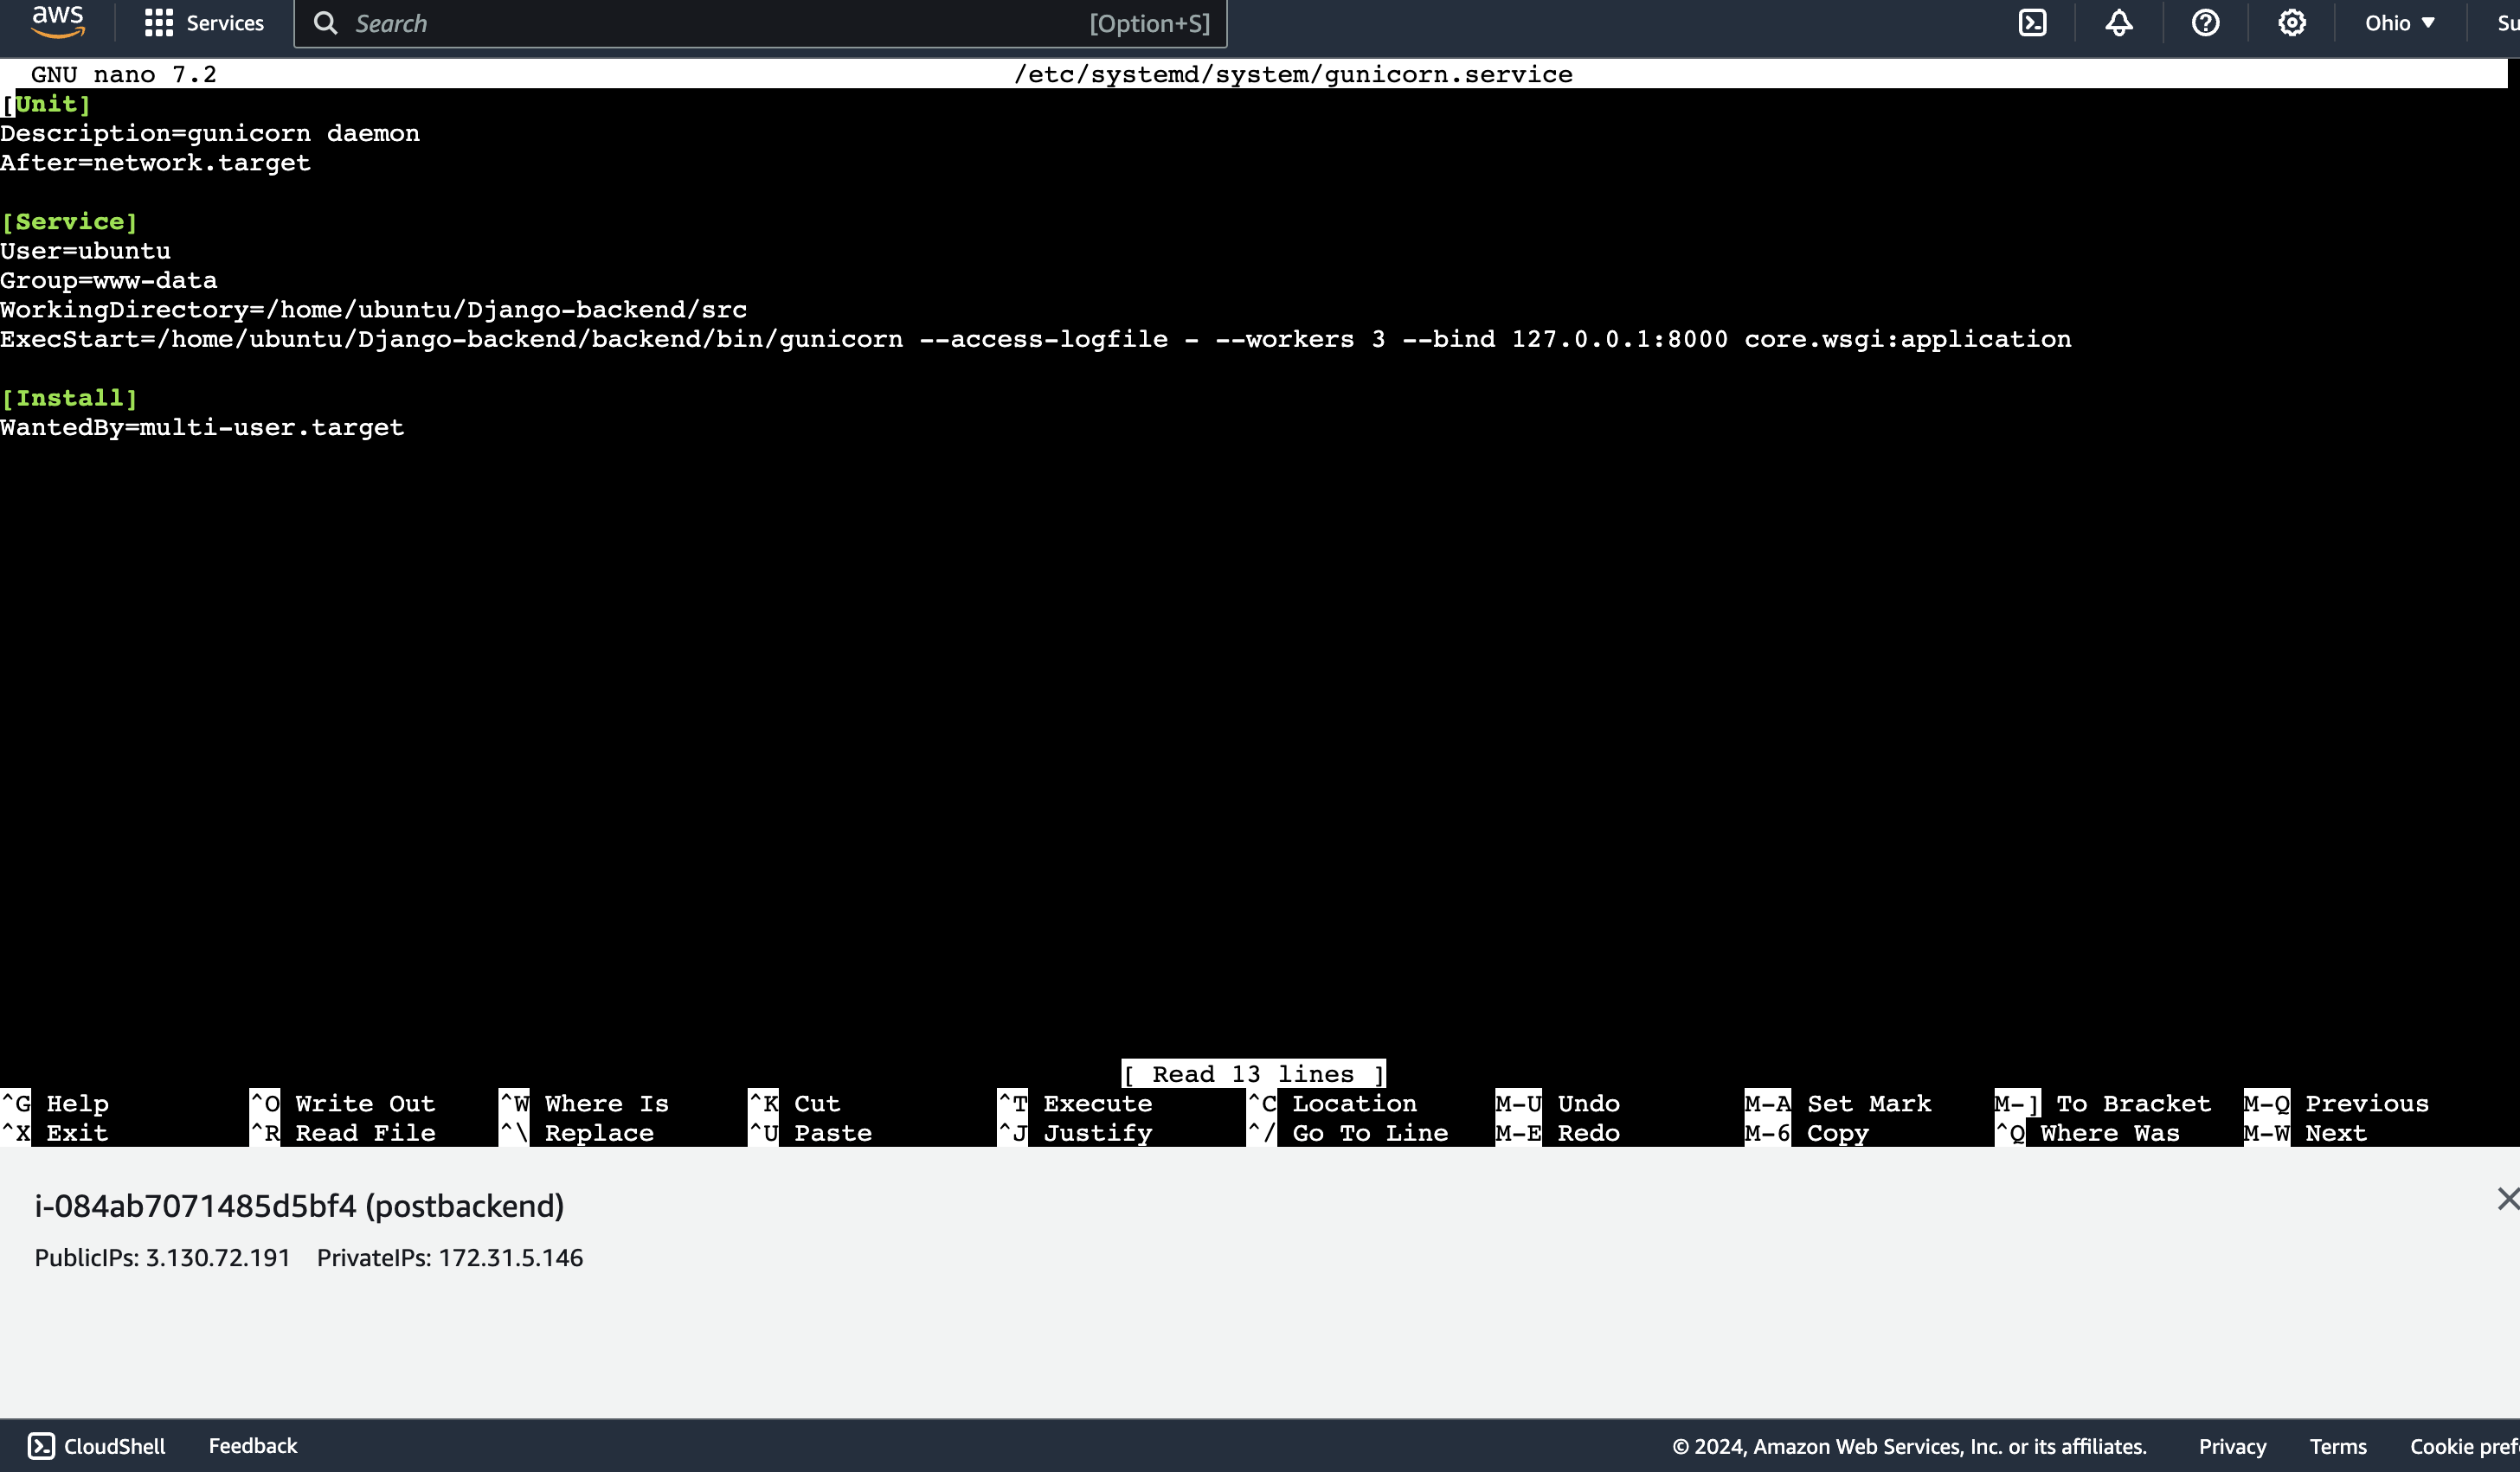
Configuration File for gunicorn

Slide 12
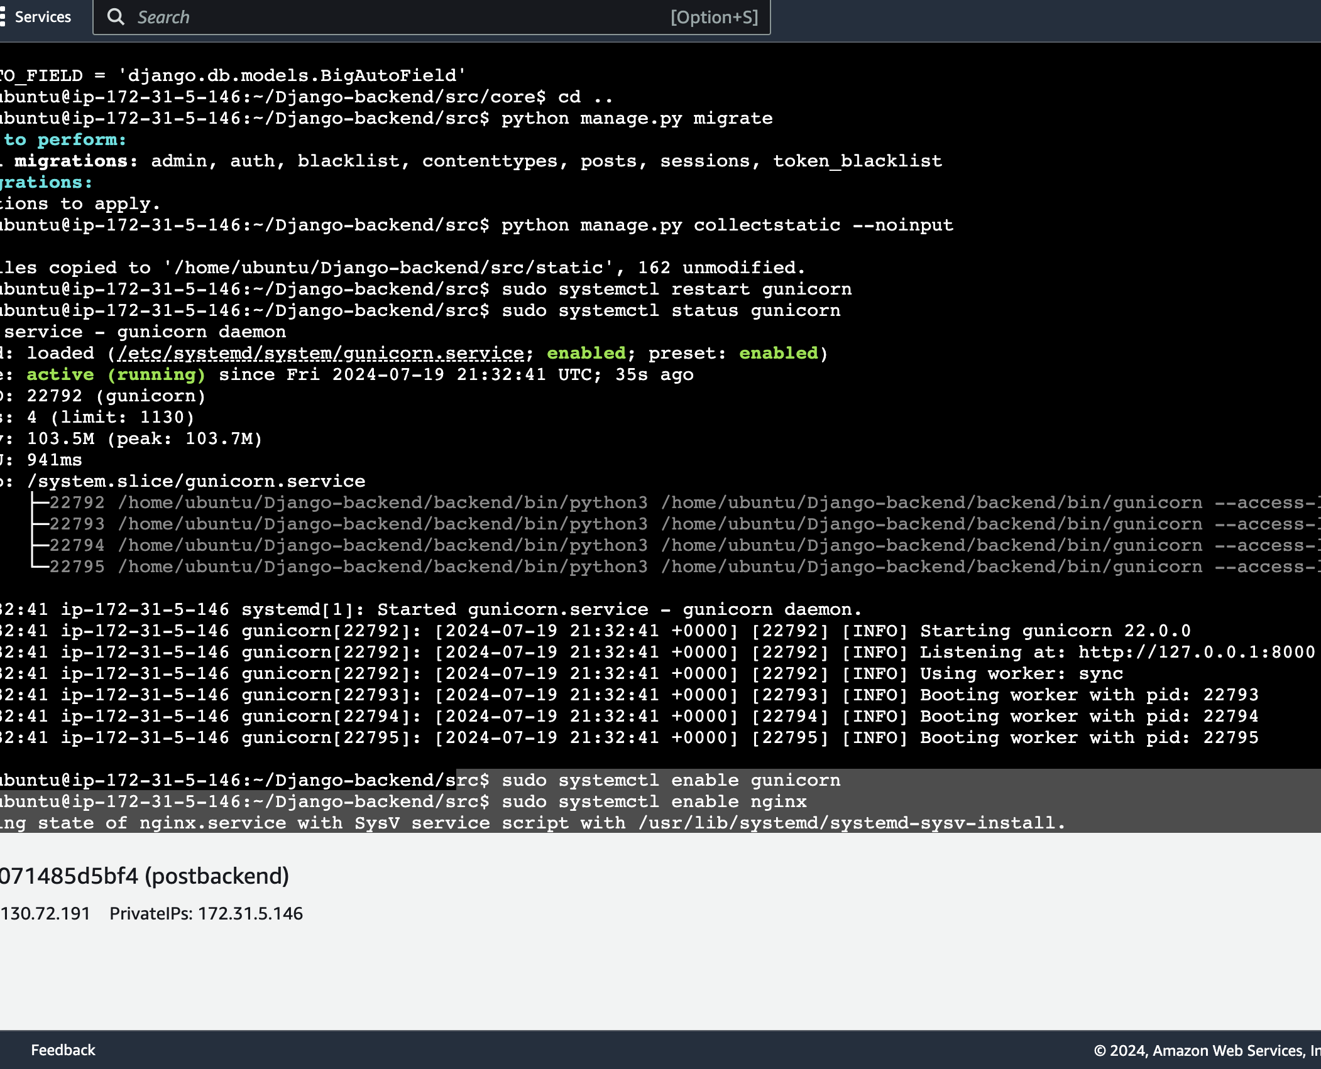
Status for gunicorn service:

Slide 13
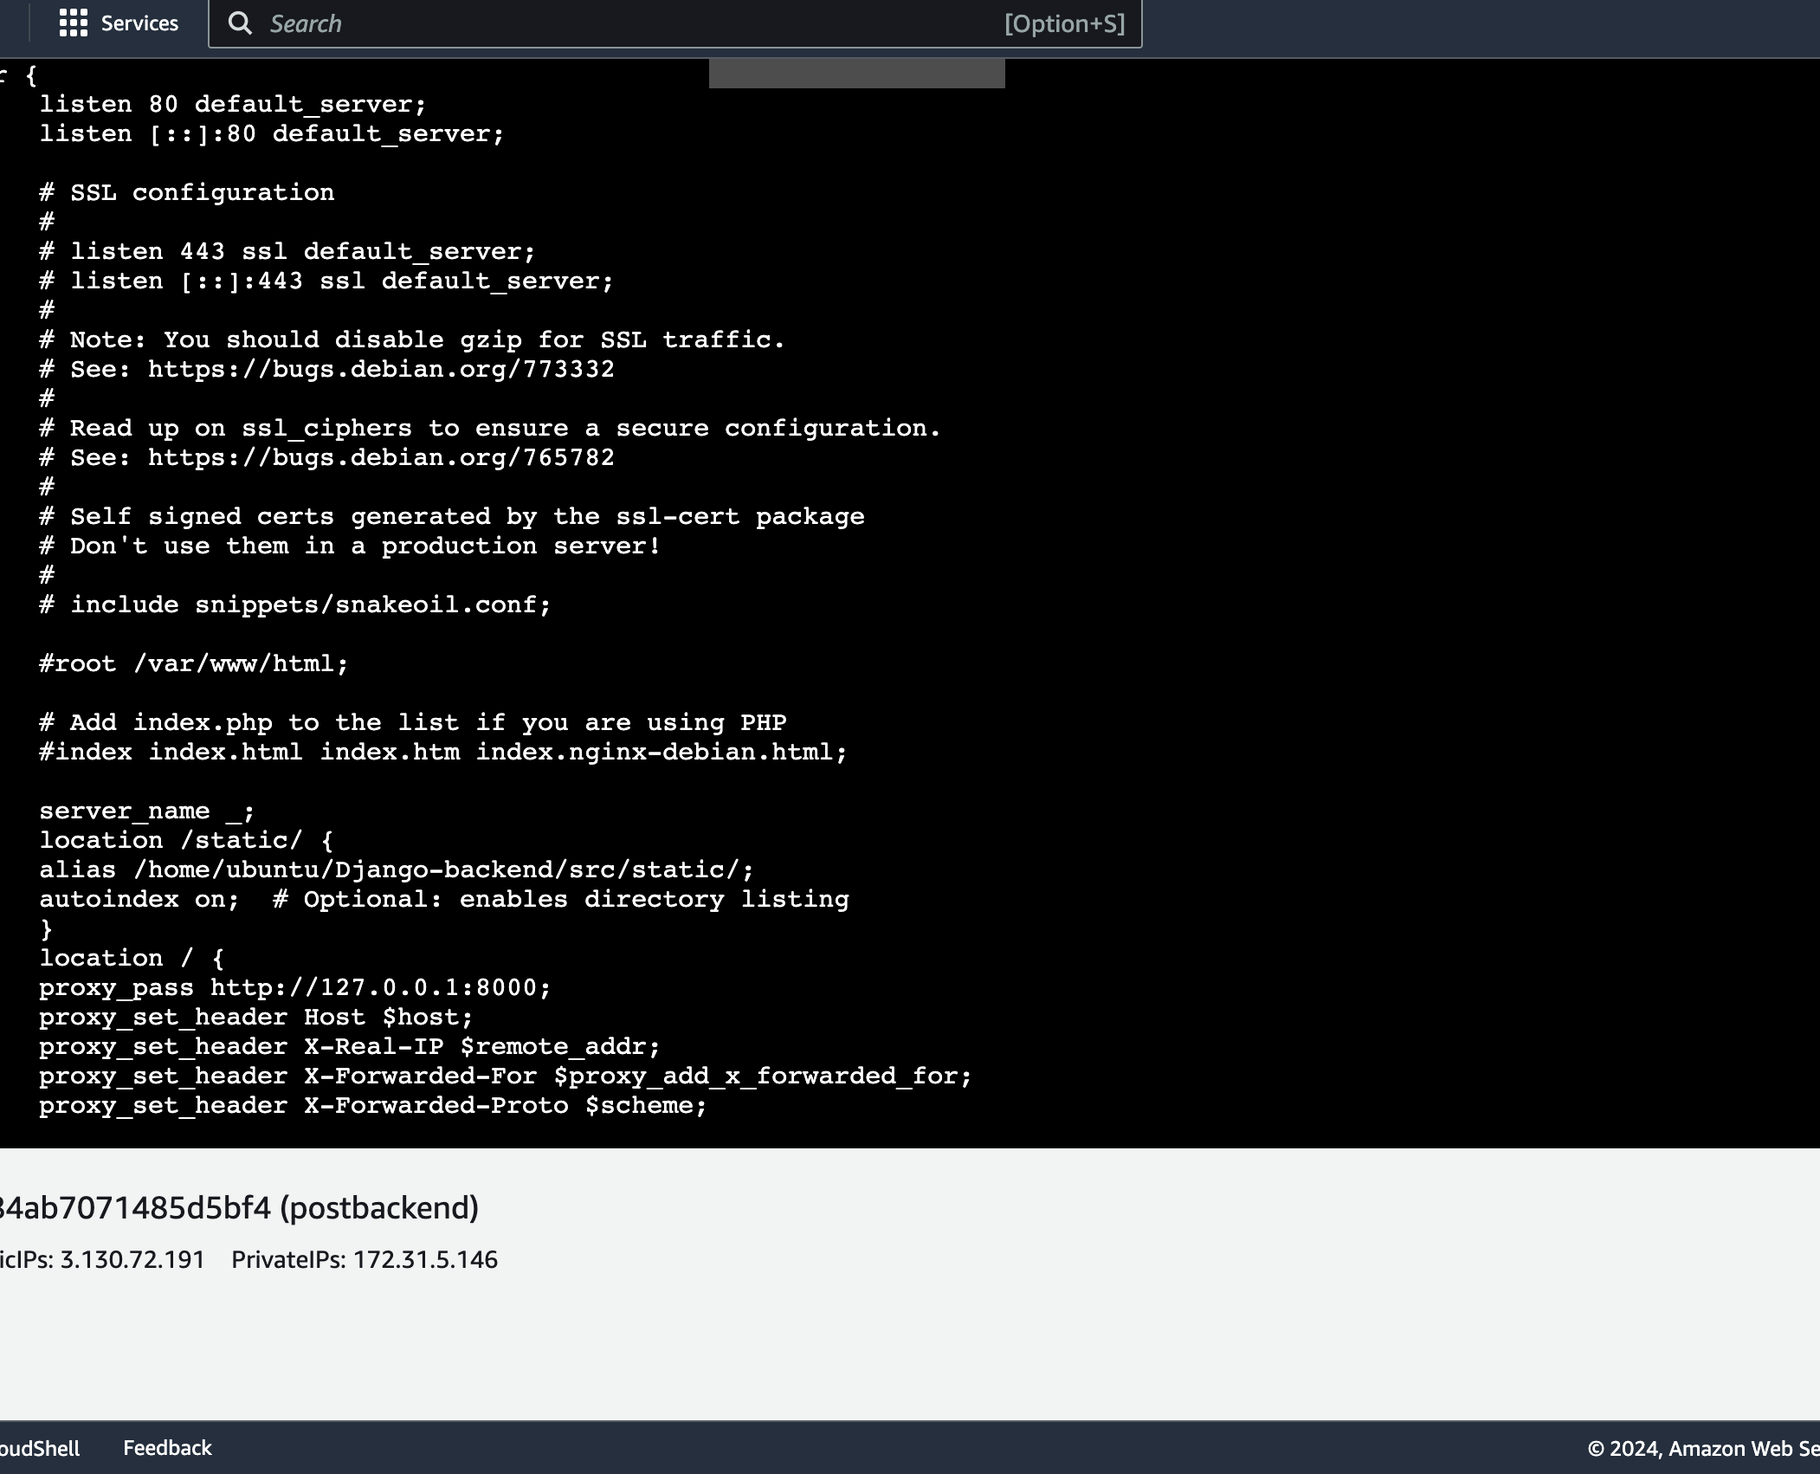
Configuration File for nignix
sudo nano /etc/nginx/sites-available/default

Slide 14
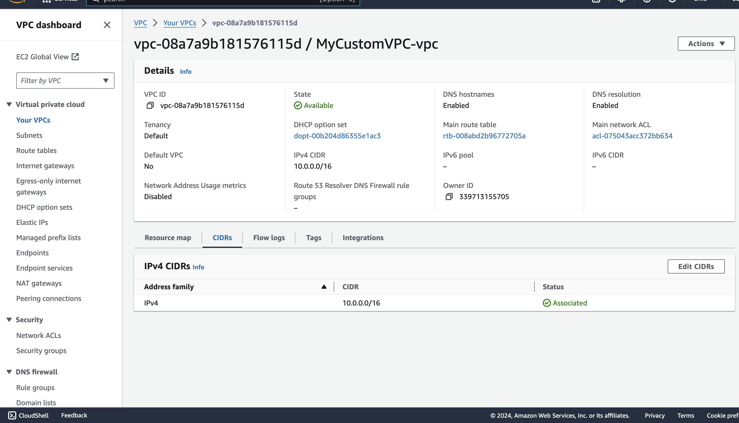

Slide 15
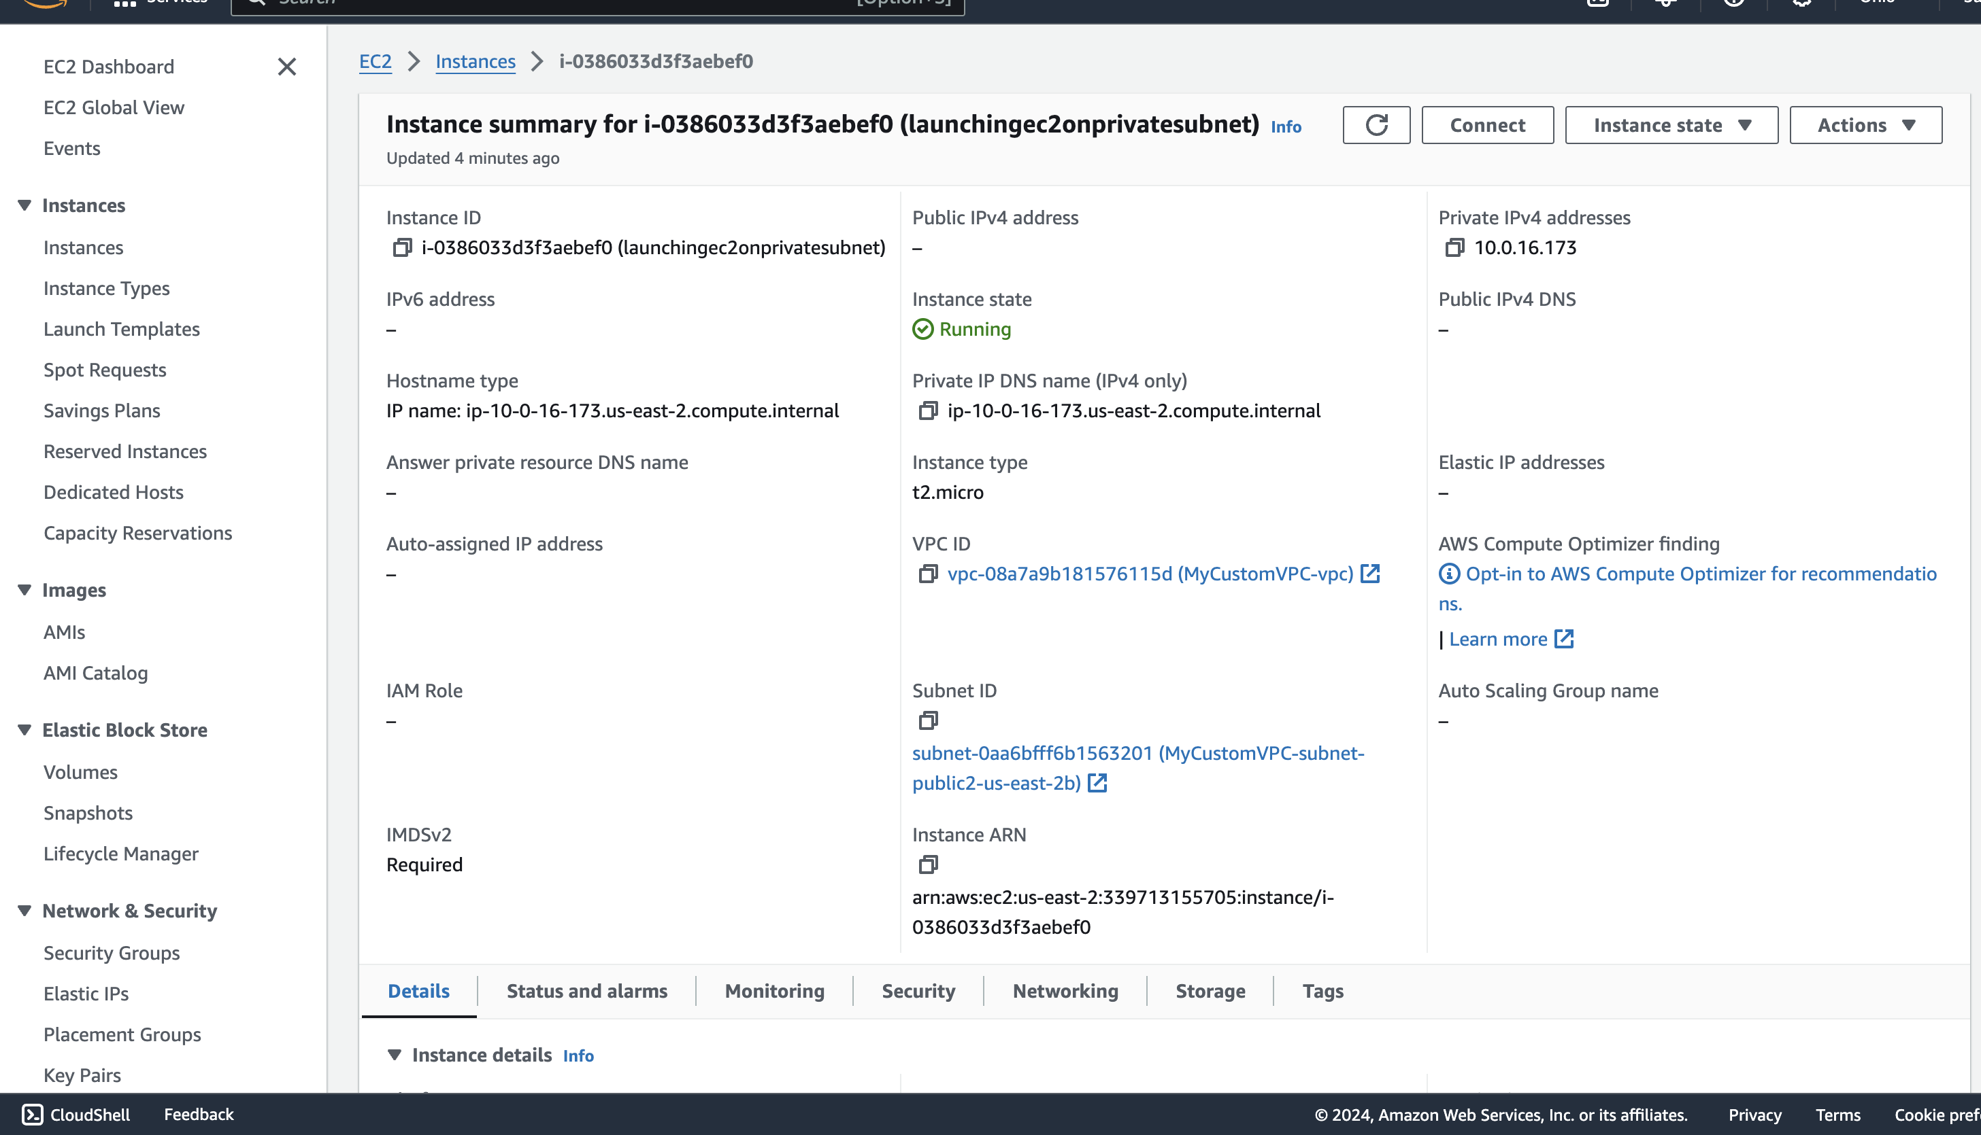

Slide 16
Tech Stack and Architecture
Frontend:
React.js: Used for building the user interface. React allows for creating reusable components which make the development process more efficient and the codebase more maintainable.
Styled-components: Used for applying CSS styling to React components in a modular and scalable way.
Backend:
Django: A high-level Python web framework that encourages rapid development and clean, pragmatic design.
Django REST Framework (DRF): Used for building the API endpoints. DRF makes it easy to build robust and scalable APIs with Django.
Authentication: Implemented using JWT tokens, with endpoints for signup, login, and logout, seeing posts and creating-posts. Tokens are stored securely in local storage on the client side.

Slide 17
Database
SQLite (Development) / PostgreSQL (Production): SQLite is used for development due to its simplicity, while PostgreSQL is used in production for its robustness and scalability.
Deployment:
AWS EC2: Used for hosting the backend server. EC2 provides scalable computing capacity in the AWS cloud.
AWS S3: Used for storing static and media files. S3 offers secure, durable, and scalable storage.
AWS CloudFront: Used as a Content Delivery Network (CDN) to deliver static content to users with low latency and high transfer speeds.

Slide 18
Key Features
User Authentication: Secure signup, login, and logout functionalities.
Posts Management: Users can view posts, like them and see count of Likes.
Secure Token Management: Access tokens are stored securely in local storage, and token expiration is handled gracefully.

Slide 19
Deployment Process to AWS
Setting up EC2 Instance:
Launch an EC2 instance with the desired configuration (e.g., Ubuntu 20.04).
SSH into the instance and update the system packages.
Configuring the Backend:
Install necessary packages such as Python, Django, and SQLITE.
Set up the Django project and configure it to use SQLITE.
Configure Django settings for static and media files to use S3.
Set up CORS configuration and secure token management.

Slide 20
Deploying the Backend:
Use gunicorn as the WSGI HTTP server and nginx as the reverse proxy.
Configure nginx to serve static files and proxy requests to gunicorn.
Set up a process manager like supervisor to manage gunicorn processes.
Setting up S3 and CloudFront:
Create an S3 bucket for storing static and media files.
Configure Django to use the S3 bucket for static and media file storage.
Set up CloudFront to distribute the content stored in S3.

Slide 21
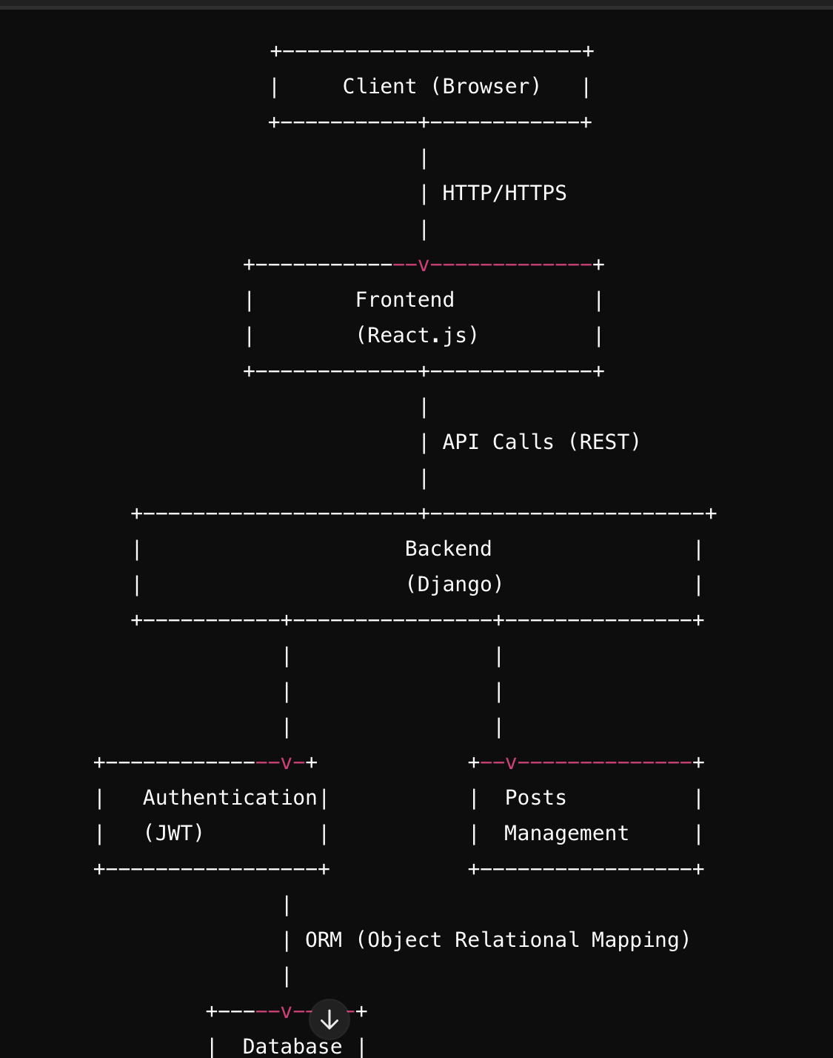
Architecture
+------------------------+
| Client (Browser) |
+-----------+------------+
|
| HTTP/HTTPS
|
+-------------v-------------+
| Frontend |
| (React.js) |
+-------------+-------------+
|
| API Calls (REST)
|
+----------------------+----------------------+
| Backend |
| (Django) |
+-----------+----------------+---------------+
| |
| |
| |
+--------------v-+ +--v--------------+
| Authentication| | Posts |
| (JWT) | | Management |
+-----------------+ +-----------------+
|
| ORM (Object Relational Mapping)
|
+-----v-----+
| Database |
|(PostgreSQL)|
+-----------+
|
| Static & Media Files
|
+-----v------+
| AWS S3 |
+------------+
|
| CDN (Content Delivery Network)
|
+-----v------+
| AWS CloudFront |
+------------+

Slide 22
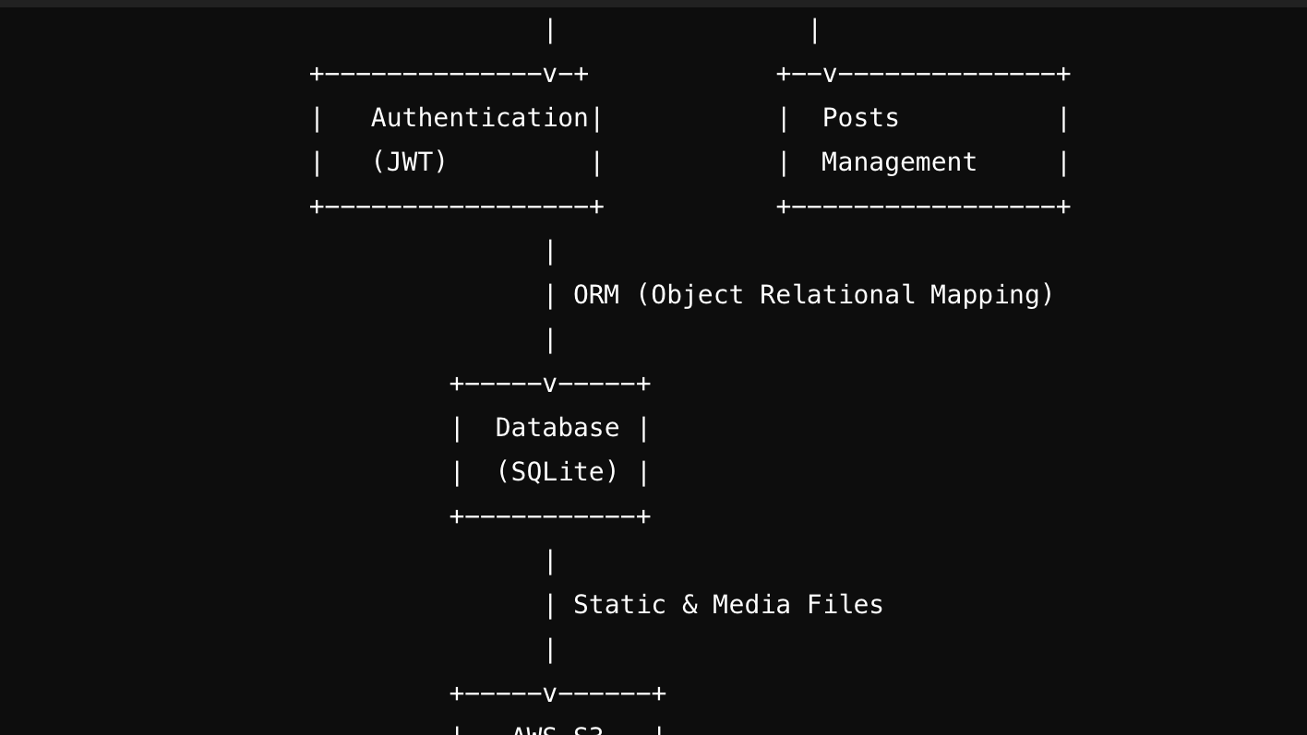

Slide 23
